Slide 1

Agriculture & Ag Lending in a Black Swan Environment
Dr. David M. Kohl
Professor Emeritus, Agricultural and Applied Economics
Member of Academic Hall of Fame, College of Agriculture & Life Sciences
Virginia Tech, Blacksburg, VA
(540) 961-2094 (Alicia Morris) | (540) 719-0752 (Angela Meadows) | sullylab@vt.edu
Macro Clinic Video Blog: www.compeer.com/education
Road Warrior of Agriculture: www.cornandsoybeandigest.com
Ag Globe Trotter: www.northwestfcs.com
Dave’s GPS & Dashboard Indicators: www.farmermac.com
May 21, 2020

Slide 2

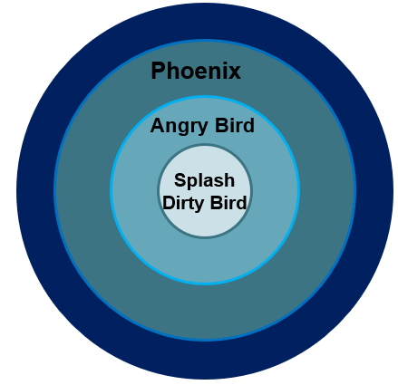
Black Swan Progression -
Dirty Bird
Dirty Bird or Phase I – Splash
(March 1 to May 1, 2020)
job losses
preventative health
consumer shutdown, back to the basics
40% consumer based economy
  0-25% of sales
global economy on life support
Business & Personal:
shock
numbness
anxiety
Needs:
time to absorb information
reality check

Slide 3
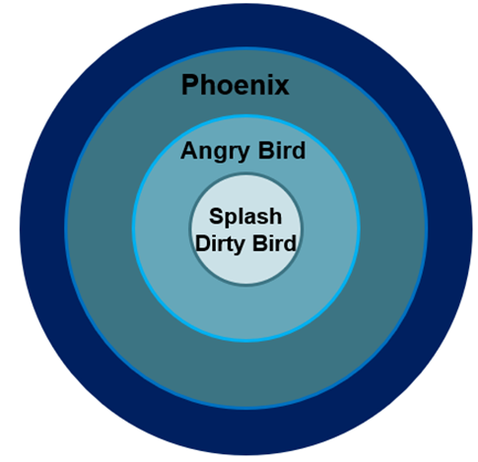
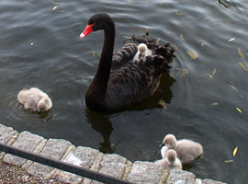
Black Swan Progression -
Angry Bird
Angry Bird or Phase II – Ripple
(May 1 to December 31, 2020)
recovery plan nationally/globally
realization of job loss
business failures
systems of health surveillance
deglobalization discussions
trade issues
volatility based on headlines
Personal/Society/Government:
revenge
blame
confusion
frustration
Needs:
support
okay to feel a loss
collaboration
critical thinking
unintended consequences
More baby black swans?

Slide 4
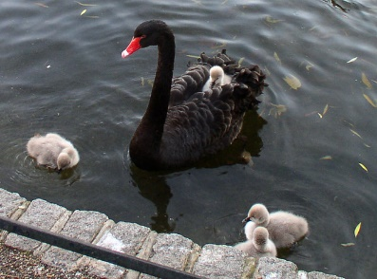
Black Swan Progression -
Phoenix “Mythical Bird”
Phoenix or Phase III – Ripple
(January 1, 2021 - 2022 & Beyond)
commitment to move forward driven by young leadership
new business models
question of consolidation:
  big business vs. small business
accelerated deglobalization
AI & privacy balance
accelerated innovation in health systems
TSA all the time
Personal:
more energy
commitment to move forward
adjustment & focus
Needs:
creative leadership
innovation
adaptation
new models for success
More baby black swans?

Slide 5

Phoenix: Business Model of the Future
resilient
agile
entrepreneurial / innovative
high business IQ
align with rapidly changing marketplace

Slide 6

Poll #1
How long do you think the recession will last?
  <9 months
  9-18 months
  >18 months

Slide 7
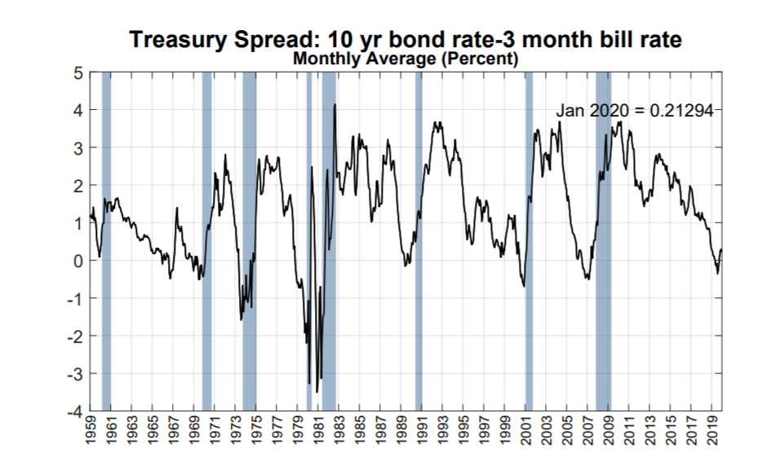
Dangerous Curves
Probability of a recession in the next 12 months as predicted by the Treasury Spread = 25.20%
Source: Federal Reserve https://www.newyorkfed.org/medialibrary/media/research/capital_markets/Prob_Rec.pdf

Slide 8
Compare & Contrast
2008-09 to 2020 1
2008-2009 Financial Shock
  asset bubble - paper wealth destruction
  central banks globally - quantitative easing
  V shaped recession
  residential & commercial real estate
  flaws in the banking system
  consumer behaviors, temporary shock
  coastal & sand states oriented

Slide 9

Compare & Contrast
2008-09 to 2020 2
2020 Pandemic
  sudden impact/shock disruption
  economic behavioral changes/basics
  no pattern corrective action- health
  Nike swoosh shaped recession
    size 6 or size 14-18?
  longer term wealth destruction
  loss of purchasing power
  re emerging bio shocks / cyber attacks
  southern hemisphere bio shocks

Slide 10
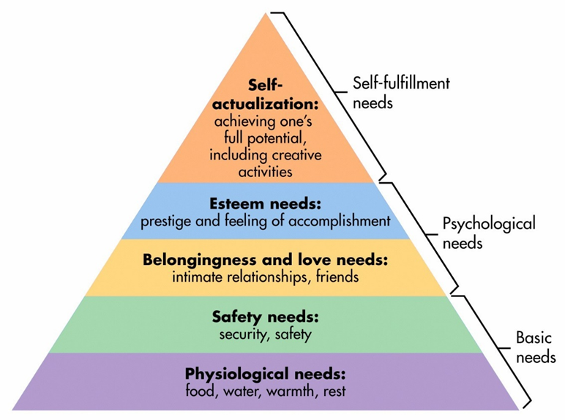
Maslow’s Hierarchy of Needs

Slide 11
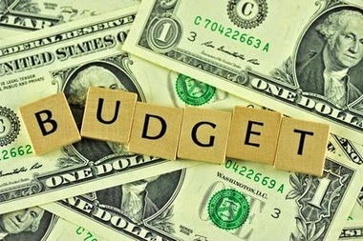
Post COVID Consumer 1
minimalist
  loss of income/wealth
  increased levels across all demographics
  very basic needs
  pride & esteem on survival
frugal
  some loss of income/wealth
  basic needs, selected experiences/expenditures
  75% spending habits of pre COVID
  pride in budgeting, savings and rainy day fund

Slide 12
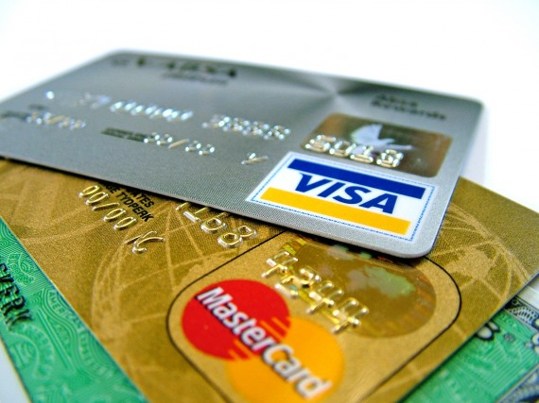
Post COVID Consumer 2
carefree consumer/pogo stick syndrome
  impulse & emotionally driven
  pent up energy & demand
  hits ground running
  hit the wall post stimulus
  live on income, wealth & credit card
alpha spender / investor
  strong wealth & income
  revert to high end purchases
  risk taker with a focus on discounted opportunities
  wealth cushion creates shock absorber to future black swan events

Slide 13
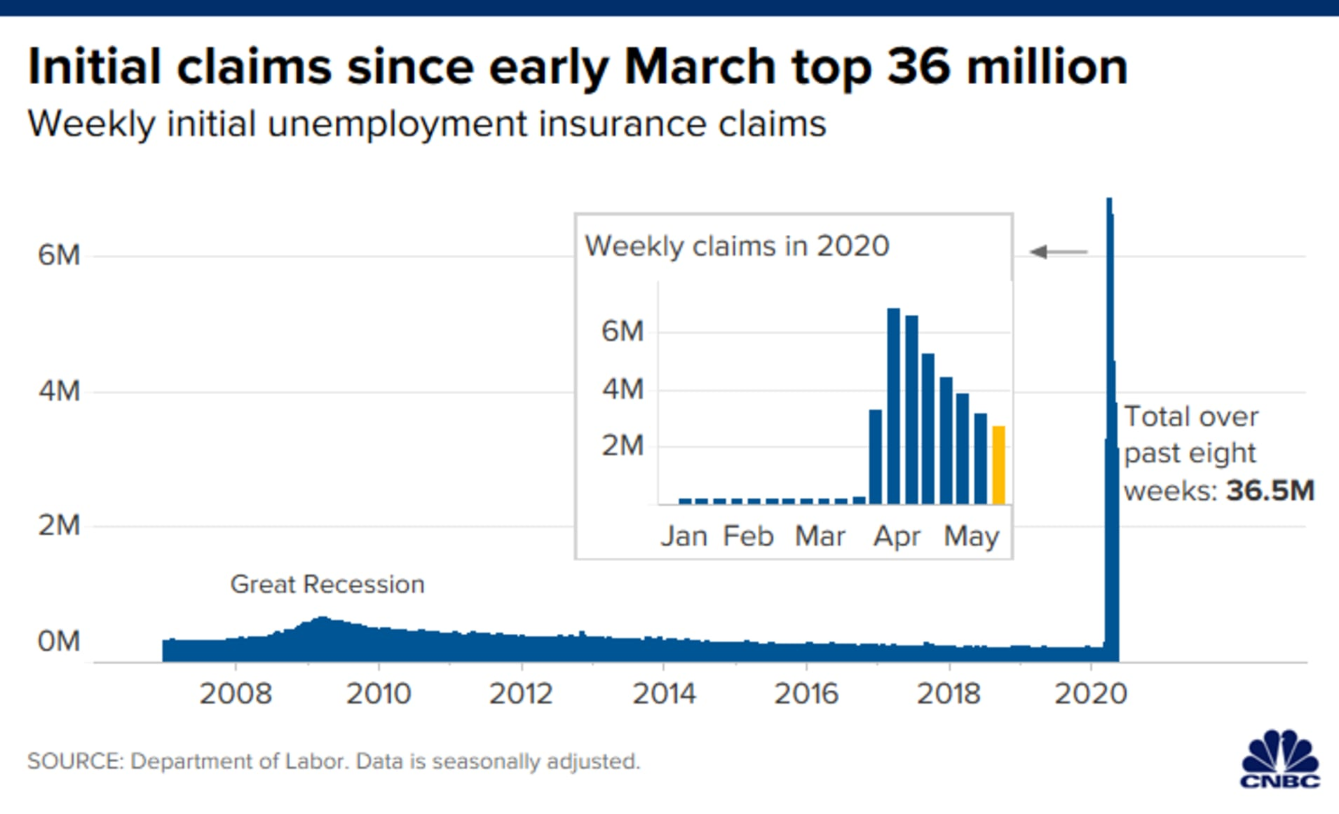
36.5 Million Filings for Unemployment Benefits
Jobless Claims:
2.98 M for week ending 5/9
3.17 M for week ending 5/2
3.84 M for week ending 4/25

Slide 14
Economic Indicators Watchlist
May & June
Indicator | Pre COVID | COVID
Purchasing Managers Index (PMI)* | 50+ | <40
Consumer Sentiment** | 90 to 100 | <70
Unemployment Rate: U-3 & U-6 | 3.5% to 7.0% | 14 to 30%
Factory Utilization | 76% - 78% | <70%
Housing Starts | 1.5 M | <800,000
Copper Prices | $2.60/lb. | <$2.00/lb.
Quarterly Economic Growth | 2.0% | <-30%
LEI (Leading Economic Index) | Positive trend | Decrease by 7.5
*U.S./Rich Nations observation
**University of Michigan: Consumer Sentiment

Slide 15

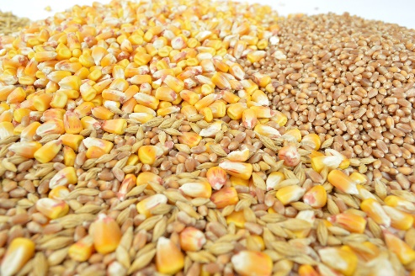
Macro Farm Economics-
Grain
ethanol
  oil prices <$20 barrel
  breakeven $40/barrel
  demand for corn
  $2.50 to $3.50 range
positive livestock sector on cost side
cotton prices
soybean prices
wheat prices
weather
strength of the dollar
economic health of importing countries

Slide 16
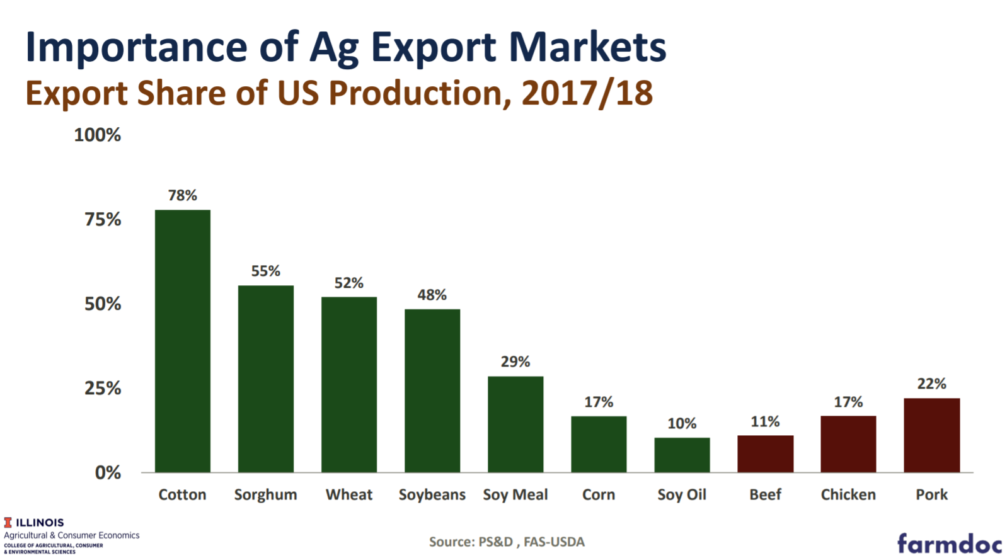

Slide 17
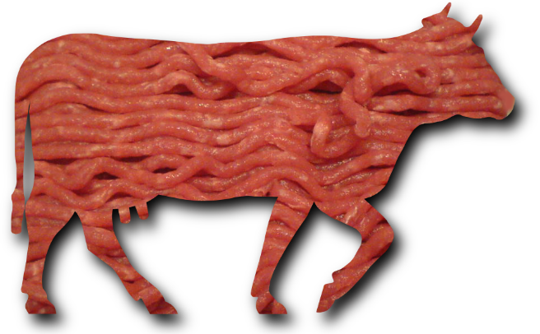
Macro Farm Economics- Livestock
schools & universities
restaurants- retail food business
supply chain issues
  U.S./North America
  globally
economic health
  Canada
  Mexico
  Japan
  China
  Europe

Slide 18
Poll #2
The number of inquiries related to rural properties since COVID-19 have:
  increased.
  remained the same.
  decreased.

Slide 19
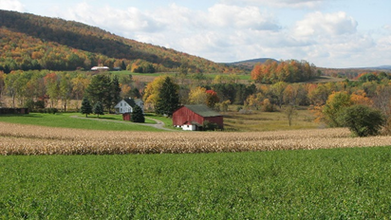
COVID-19 Land Values
last line of defense
equity bridge that provides economic bridge
rise of interest rates
drastic policy changes
  refinances
  movement towards cash
demand increase for rural properties

Slide 20
COVID-19 The Black Swan Disruptor- Positives for Agriculture
importance of a diversified safe food, fiber & fuel source- basics of life
reassurance of transparency in where food is produced, processed & distributed
healthy soil & water
  plants, humans, animals & environment
local niche markets, agritourism, post COVID boom
repositioning of the image of agriculture

Slide 21
Customer Plan for Navigating the Whitewater of COVID-19
Black Swans to Phoenix
get financials in order, document your losses
conduct 3 to 4 years of trend analysis
assess equity depletion
open communications with your lender
seek counsel from accountant on sale of assets
one page action plan in writing
seek financial and mental health counseling if needed

Slide 22
Business IQ: Management Factors
Critical Questions for Crucial Conversations

Slide 23
Business IQ: Management Factors
Critical Questions for Crucial Conversations 1
Progressive Business Characteristics:
To be considered a “Progressive” Business, farms must score in the green in four of these five checklist items (#2, #6, #7, #8, #14).
#2 Know cost of production by enterprise: Know the cost of production by enterprise and are able to readily explain which enterprise is the most profitable.
#6 Financial sensitivity analysis: Know how changes in price, production, cost and/or interest rates affect the bottom line. Complete different scenarios in their cash flows to test this for their business/operation.
#7 Understand financial ratios: A dashboard of financials (5 to 7 ratios) that they do a 3 to 5-year trend analysis on their business? Second, benchmark these ratios to other businesses like the Illinois FBFM or University of Minnesota’s FINBIN.
#8 Work with an advisory team and lender: Establish an advisory team consisting of a lender, crop or livestock consultant, and possibly a financial planner, etc. If so, do they meet 2 to 4 times a year?
#14 Educational seminars/courses: Attend or take five educational seminars or courses a year. One should be outside of the industry of agriculture.
Developed by: Dr. David M. Kohl, Professor Emeritus, Ag & Applied Economics, Virginia Tech

Slide 24
Business IQ: Management Factors
Critical Questions for Crucial Conversations 2
Struggling Business Attempting Turnaround Characteristics:
To be considered attempting a successful turnaround, farms must score in the green in four of these five checklist items (#3, #5, #8, #11, #12).
#3 Goals - business, family & personal: Written business, family and personal goals.
#5 Projected cash flow: Completed a cash flow.
#8 Work with an advisory team and lender: Exhibit willingness to be coached by an advisory team and lender.
#11 Modest lifestyle habits, family living budget: Take modest family withdrawals and have a family living budget.
#12 Written plan/business owner plan: Developed and executed a one-page written plan on how they will improve cash flows, profits and what is the likelihood of the turnaround of business. If not, problems can continue.
Developed by: Dr. David M. Kohl, Professor Emeritus, Ag & Applied Economics, Virginia Tech

Slide 25
Lender Plan for Navigating the Whitewater of COVID-19
transparent communications between relationship officer, analyst and loan committee
interest only or principal deferment where appropriate
documentation if SBA & USDA program was utilized
3 to 4 years of trend analysis to isolate COVID losses
watch build up of non-traditional debt
be sensitive to knee-jerk reaction
  reputation risk/community risk
mental recharge

Slide 26
Poll #3
How has the amount of customer interaction changed during the COVID-19 pandemic? It has:
  increased.
  decreased.
  remained the same.
What has been your primary mode of interaction with customers?
  Phone call
  Text
  Email
  Face-to-face
  Video call
  Postal mail
  Social media
  Other

Slide 27

Positive Lender Dialogue
understanding & patience
  customer
  lender
team work (analyst / relationship officer)
team with government assistance programs
  FSA
  agribusinesses
  others
value added by lenders
  curbside service
  assist with technology
  assist in planning, strategizing, executing, monitoring

Slide 28

Wisdom for Well-being
meaning of life- Simon Sinek’s “Start with Why” & questions: how, what & why?
meditate
  shut down the drama
  hear the silence
  platform of peace
exercise
  endorphins
  routine
  work & life balance
diet
  physical health
  feel guilty once in awhile
sleep
  replenish the body
positive support network
  financial net worth is not equal to self worth in life

