Slide 1
PPP loan forgiveness
The Paycheck Protection Program enabled many midmarket businesses to obtain loans through financial institutions and the Small Business Administration that will be forgiven if the borrower meets defined requirements. Now that many lenders have processed hundreds or thousands of these loans, a solution is needed to manage the forgiveness requests from their borrowers.
RSM has developed a digital process automation solution to assist financial institutions with managing this pending wave of borrower forgiveness requests.
Secure borrower access
RSM’s PPP loan forgiveness solution leverages Appian’s highly secure cloud, which has certifications for the highest security standards, including HIPAA, FEDRAMP, FISMA and several others. This enables the solution to be implemented quickly with minimal lender technology support.
Efficient data collection for analysis
The solution supports uploads for documents of almost any file format and will associate the document with the corresponding forgiveness topic area (i.e., mortgage statements, payroll, utilities).
Structured and facilitated process
Key features of the solution
The forgiveness request process is outlined for borrowers so they understand what information they need to complete the request. This structured process captures the borrower input as well as the lender analyst’s review of the request. This ability provides a clear audit trail of the request, which allows for a clear request for the future.
Provide a borrower portal for loan forgiveness requests
Manage process via workflow
Manage loan forgiveness compliance requirements
Collect and store required documentation directly via portal
Ongoing support before and after implementation
Our team offers support not only during implementation, but also for the processes critical to the technology’s success. The team brings skills built off countless successful technology integrations.
Manage all borrower loan forgiveness applications
Easy import of PPP loan data to enable a rapid start for lenders

Slide 2
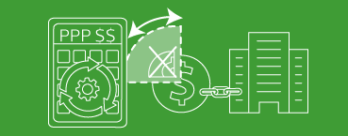
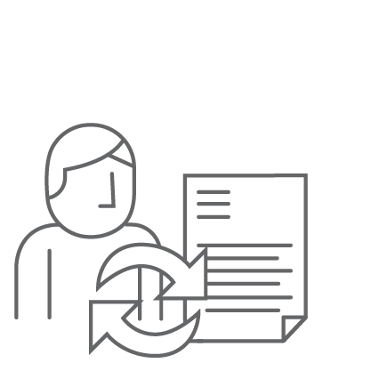
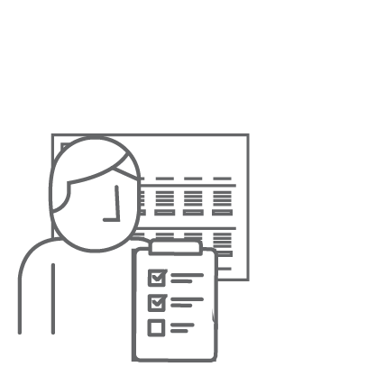
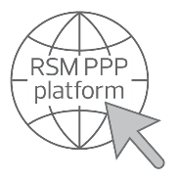
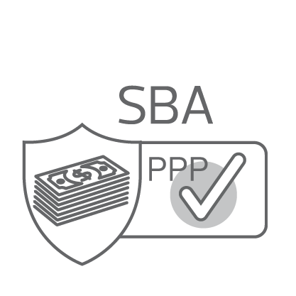
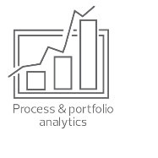
EXPERIENCE THE POWER OF BEING UNDERSTOOD®
Flexible deployment options
Financial institutions practice
The PPP loan forgiveness solution can be deployed with clients in a few different models. RSM can provide a fully outsourced service for forgiveness request management where skilled RSM professionals can provide the review of the request and documentation before final approval from the financial institution’s management. As an alternative, the financial institution can purchase the RSM PPP forgiveness platform so it can be used by the lender’s internal team and RSM can provide technical support as needed. These are just two example delivery models that could be used for this solution.
RSM services more than 3,000 financial institutions and specialty finance companies nationwide, including banks and savings institutions, credit unions, mortgage companies, finance and leasing companies, and other specialty lenders. Our clients range from newly chartered institutions to those with billions in assets.
Our risk, finance and technology professionals deliver value based on understanding our clients’ industries, organizations, goals, challenges and competitive environment.
What is the process?
The details of the PPP loan forgiveness process are still being defined by the SBA, but the following is a high-level overview of the process that RSM expects to be used. The RSM solution is specifically built on a technology platform that can be rapidly customized once the detailed requirements are released.
Mike Courtney
National Technology and Digital Leader
Borrower portal
Lending analyst review
Lending manager review
Application submission and reporting
Secure access with credentials provided
Preloaded loan information for application process
Enter data, supporting documentation and certifications
System calculations on loan forgiveness
Reviews borrower submission
Accuracy
Completeness
Compiles submission deficiencies to be addressed by borrower
Following resolution of deficiencies, submits for manager review/approval
Monitors process queue performance
Reviews loan forgiveness package and comments
Approves or rejects for further clarification/ remediation
Monitors/manages process performance
Evaluates overall portfolio state (approved, in-process, etc.)
Forgiveness package for SBA submission
Summary loan reports
Overarching portfolio reports
Process audit trail
Mike.Courtney@rsmus.com +1 972 764 7080
John Behringer National Financial Institutions Consulting Leader
John.behringer@rsmus.com +1 312 634 5905
This document contains general information, may be based on authorities that are subject to change, and is not a substitute for professional advice or services. This document does not constitute audit, tax, consulting, business, financial, investment, legal or other professional advice, and you should consult a qualified professional advisor before taking any action based on the information herein. RSM US LLP, its affiliates and related entities are not responsible for any loss resulting from or relating to reliance on this document by any person. Internal Revenue Service rules require us to inform you that this communication may be deemed a solicitation to provide tax services. This communication is being sent to individuals who have subscribed to receive it or who we believe would have an interest in the topics discussed.RSM US LLP is a limited liability partnership and the U.S. member firm of RSM International, a global network of independent audit, tax and consulting firms. The member firms of RSM International collaborate to provide services to global clients, but are separate and distinct legal entities that cannot obligate each other. Each member firm is responsible only for its own acts and omissions, and not those of any other party. Visit rsmus.com/aboutus for more information regarding RSM US LLP and RSM International. RSM, the RSM logo and the power of being understood are registered trademarks of RSM International Association. © 2020 RSM US LLP. All Rights Reserved.

